Slide 1
hotstar
By – Khyati Gupta

Slide 2
CONTENTS
Project Scope
Project features
Website structure
Website demo

Slide 3
SCOPE
Design the landing page of hotstar.com
Use vanilla html 5 and css.
Design doesn’t need to responsive.
Site is not SEO-friendly

Slide 4
FEATURES
The design used following web features –
Single page design
Nested list for site navigation
Image carousel
Video cards

Slide 5
WEBSITE STRUCTURE

Slide 6
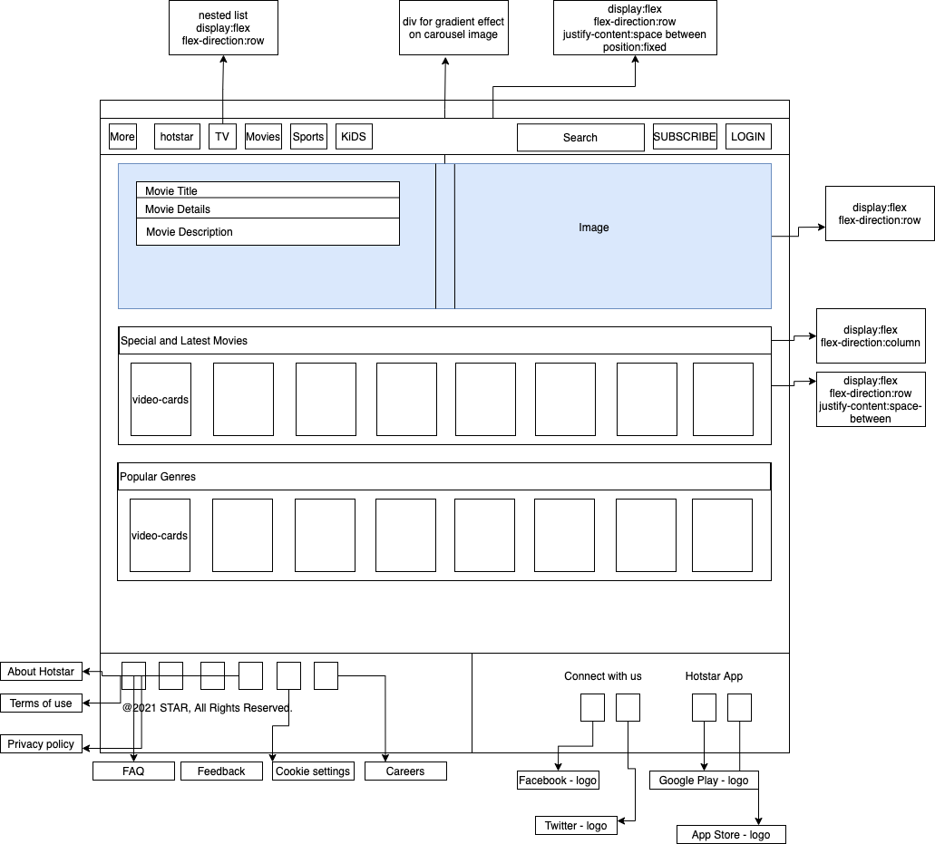

Slide 7
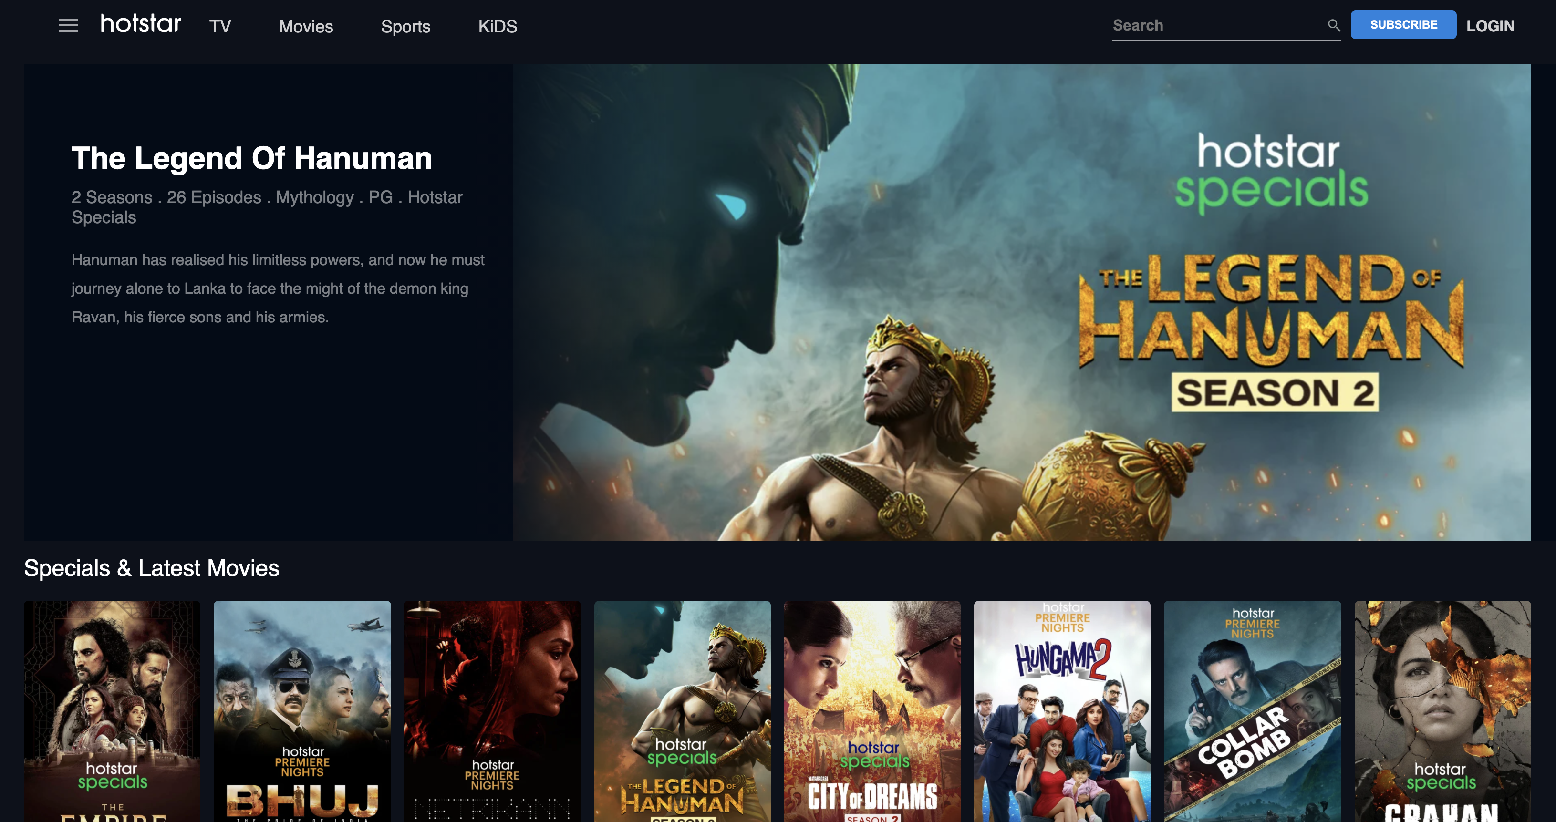
DEMO
URL : http://127.0.0.1:5500/hotstar-clone/index.html

Slide 8
Thank You!
Khyati Gupta

